Slide 1


Knowledge Management Benefits

Slide 2
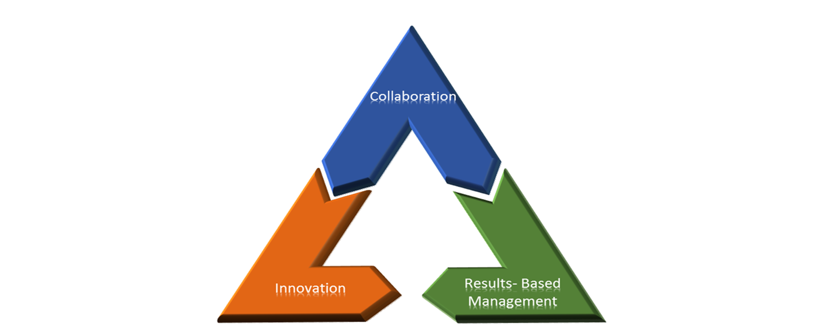
KNOWLEDGE MANAGEMENT
Empowering our Personnel
Creating value for our Member States

Slide 3
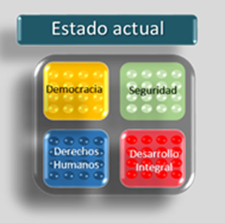
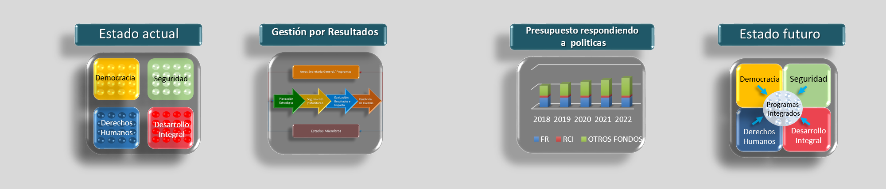
Transitioning from:
To:
Current State:
Siloes
Limited collaboration
Uni-sectoral approach
Future State:
Integrated-Program
Approach
Making information and knowledge available when we need it,
to deliver greater value to our Member States.
To achieve shared
Organizational Objectives
KM DELIVERING VALUE TO OUR MEMBER STATES, enabling a collaborative, agile, solution-oriented work environment.

Slide 4
Access to information and knowledge enhances the OAS’ relevance and strengthens its capacity to respond effectively to the challenges faced by Member States.
Member States are expecting services and products that benefit not from an individual’s knowledge or a departments or a Secretariats, they are expecting to benefit from the cumulative knowledge of the Organization.

Slide 5
KM Value for the OAS
Capture knowledge before it is lost to create organizational memory
Collaborate and communicate across organizational boundaries
Facilitate decision making
Improve productivity – decrease time to competency
Give employees easier access to critical information.

Slide 6
MANAGING OUR KNOWLEDGE AS A STRATEGIC RESOURCE
IT’S HOW WE WORK
COLLABORATE, INNOVATE, DELIVER RESULTS
Providing access to critical knowledge to carryout work functions
Increasing collaboration and coordination
Supporting better decision making
Improving productivity – decreasing time to competency
Capitalizing on our accumulated knowledge to deliver stronger programs, projects and services

Slide 7
Communities of Practice = Knowledge Sharing
Lessons learned documentation = Organizational Learning
Finding solutions collectively = Knowledge Creation

Slide 8
How will we measure our progress?
We can measure:
the % of documents accessible to personnel on shared drives by 2020 (as proxy indicator -knowledge sharing).
% of collaboration efforts that supported the development of new or improved products, services, projects or programs by the end of 2020.
% of new or improved products, services, projects or programs that get additional funding over $100, 000 by 2020.

Slide 9
Strategic Counsel for Organizational Development and Management for Results

