Slide 1

MCM
Presentation to SPR (digital workplace), Knowledge Management Unit, Skills Shed (winning idea), HR1 team, Talent Inventory team, COM (eLibrary), and RES (IMF researchers site).
By Claudia Jadrijevic and Emeric Lai Tim
September 4, 2018

Slide 2
Showcase the capabilities of the MCM Expertise Locator
Discuss the ‘lessons learned’ that could be useful for an enterprise solution

Slide 3
Team
Claudia Jadrijevic (author) – MCM
Emeric Lai Tim (developer) – MCM
Jing Zhong and Linda Venable (partners) – IMF Joint Library Partners on the work to filter staff external publications

Slide 4
Goals
Extract information about staff automatically from already existing data sources
Complement this information with self-declared areas of expertise and languages
Organize and display the information in a dashboard
Make it easily searchable – Google-like
Let the users consume the data and assess the expertise

Slide 5
Uses
HR teams looking to staff missions
Managers looking to hire people
Project leaders looking to form a team
Staff interested in connecting with others working on similar topics
Teams looking for specific areas of expertise
… curiosity (competition is good!)

Slide 6
Who
Economists
Financial Sector Experts
Managers
Assistants
Other career streams:
  Human Resources
  Capacity Development (TA)
  Budget
  Knowledge & Information Management
  Technology

Slide 7
Identifying staff expertise…
Self-declaring areas of expertise can be biased, may lead to too much or too little
Assigning areas of expertise can be biased, is time consuming
Keeping areas of expertise in a database is time consuming, easily becomes out of date
Differentiating between areas of expertise and skills is important and complement each other

Slide 8
Future…
This project is easily scalable to include all Fund staff.
It will require some resources and effort to clean up the data… needed anyway for future projects including the Digital Workplace, HR1 project, and others.
With a little investment we could install an intelligent software that ingests all information, processes it, and uses algorithms to narrow down and rank staff expertise.

Slide 9
Data Sources:
MySite. Basic information, i.e. department/division, title, email, phone.
MCM Policy Responsibilities. Staff assignments to different policy areas, i.e. central bank governance, inflation targeting, Islamic banking and finance, macroprudential policy.
MCM Country Responsibilities. Staff assignments for country work, i.e. team lead, country manager, article IV participant.
Travel Information System (TIMS). Country missions.

Slide 10
Data Sources… continued
Self-declared areas of expertise. Staff select from the Enterprise Business Vocabulary (EBV) the economic topics they have expertise with, plus other skills.
Self-declared language(s).
Institutional Repository (IR). Internal papers and TA reports.
External Publications. Curated staff CV in electronic format, including a biography, education and work experience.
Internal documents from eDocs DM.

Slide 11
LIVE DEMO!
Let’s Dive In …

Slide 12
Lessons learned (1)
ALL DATA SOURCES: Use staff name from IMF active directory
MySite. Incomplete information. Not user friendly. Staff won’t use it.
MCM Policy Responsibilities. Data in multiple Excel spreadsheets, moved to a database format in SP.
MCM Country Responsibilities. Data in multiple Excel spreadsheets, duplicate entries, spelling errors, parts out-of-date, moved to a database format in SP.

Slide 13
Lessons learned (2)
Travel Information System (TIMS). Allowed to filter only 10 years. Allowed to filter only the period when staff are working in MCM.
  Assignment codes (mission topics) are too general, too few, do not reflect the exact topic of the mission. Staff roles are too general, too few, do not reflect the exact role of staff on the mission.
  No process to perform quality control in place.
  Prone to human error.

Slide 14
Lessons Learned (3)
Self-declared areas of expertise. Pilot included 55 people. Different suggestions: a) pick as many as needed from EBV is good; b) narrow the selection to 3 top areas of expertise from a pick list of 6-10; b) expertise needs to be vetted by managers; c) expertise should be identified by managers; d) expertise is one thing and skills is another – they complement each other – should also require staff to select a skills set.

Slide 15
Lessons Learned (4)
Self-declared language(s). Easy. No need to declare the proficiency level. Reputational risk if declared incorrectly.
Institutional Repository (IR). Metadata for authors is largely incomplete or incorrect. Author(s) field needs to be mandatory. Majority of older documents do not have an author, or author’s name was misspelled. MCM backfilled the metadata for TA reports using text mining.

Slide 16
Lessons Learned (5)
External Publications. Partnered with the experts at the IMF Library (J. Zhong and L. Venable). Selected to use ORCID to create an electronic CV for 36 people (pilot) and extracted the publications into the expertise locator (clean and easy!).
  ORCID is a unique identifier that solves author name disambiguation problem. The CV is created, curated and updated by the person and moves wherever the person goes go. Updates can be pushed back into ORCID. People can select the level of visibility of each publication. It will be used by COM on all IMF publications in eLibrary and many open science companies like Google and RePec already use it. Good and solid API, easy to mine.
  ORCID has many benefits. Ideally adopted by all staff. For more information refer to ORCID video

Slide 17
Lessons Learned (6)
Internal documents from eDocs DM. Metadata for authors is largely incomplete or incorrect. MCM backfilled the metadata.

Slide 18
Sample Staff Profile

Slide 19
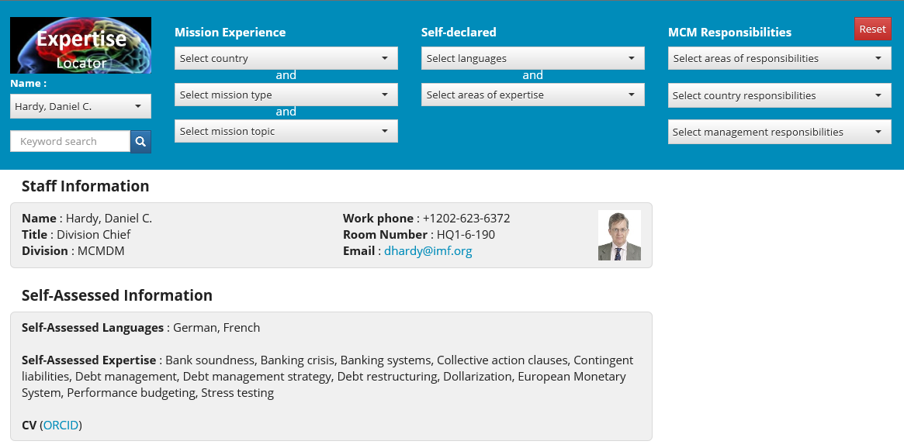

Slide 20
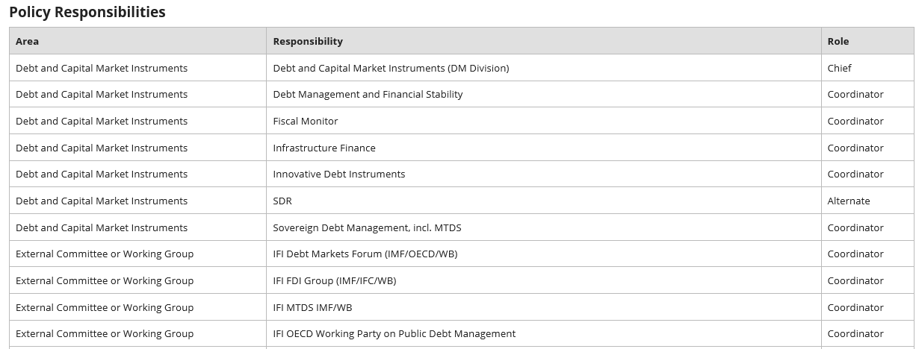

Slide 21
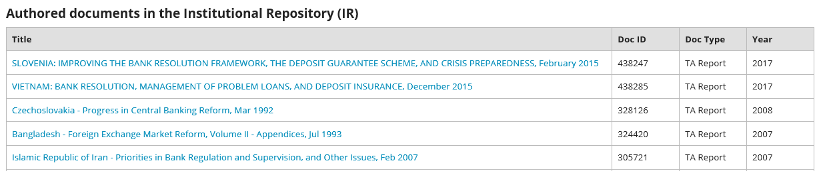
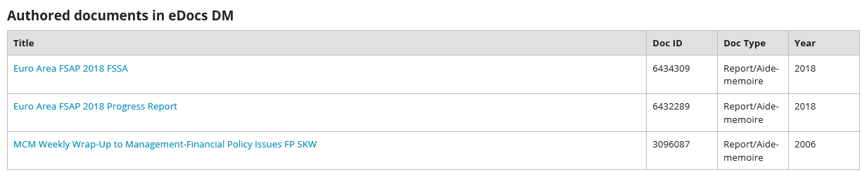

Slide 22
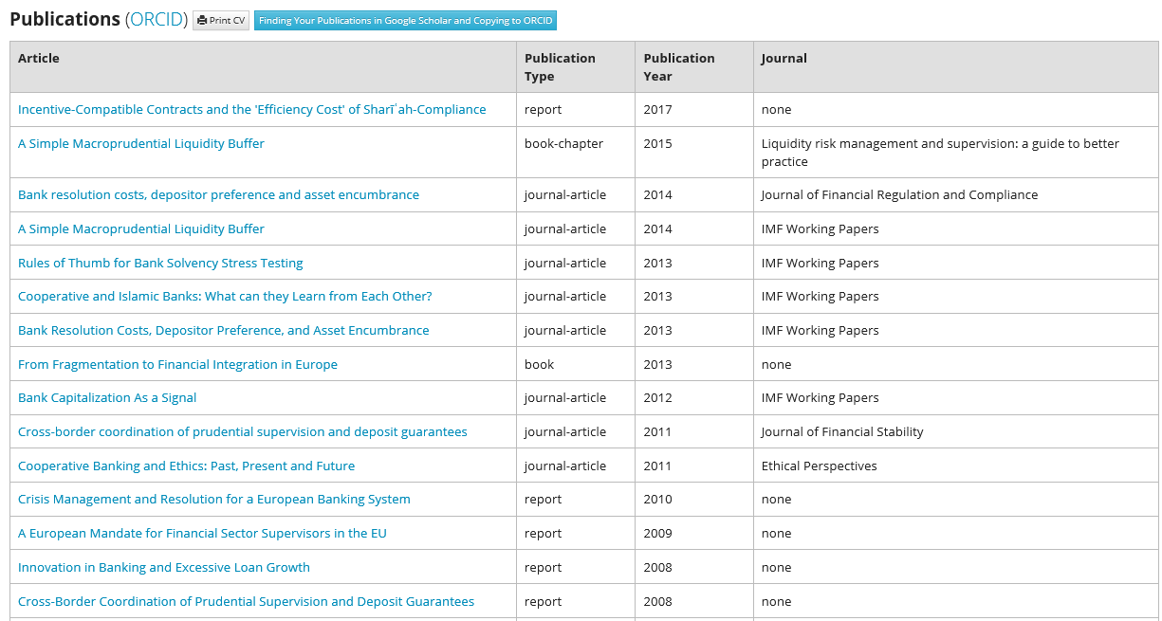

Slide 23
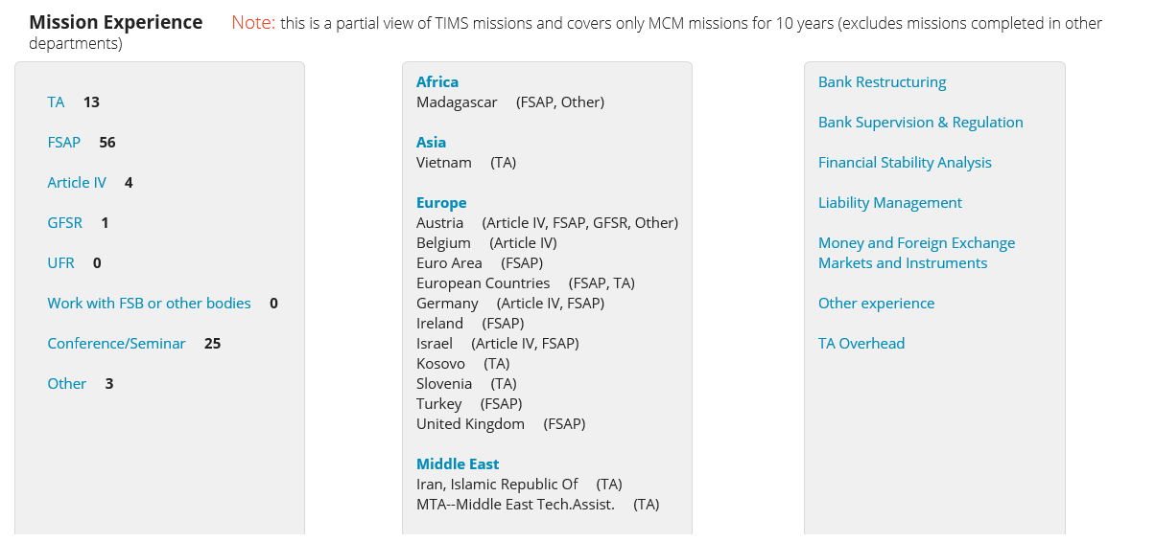

Slide 24
SEARCH CAPABILITIES
Sample Size
- All MCM Staff for missions, responsibilities, documents
- 73 Self-declared profiles
- 36 ORCIDs (external publications)

Slide 25
Sample Search Results 1:
Keyword search on all content

Slide 26
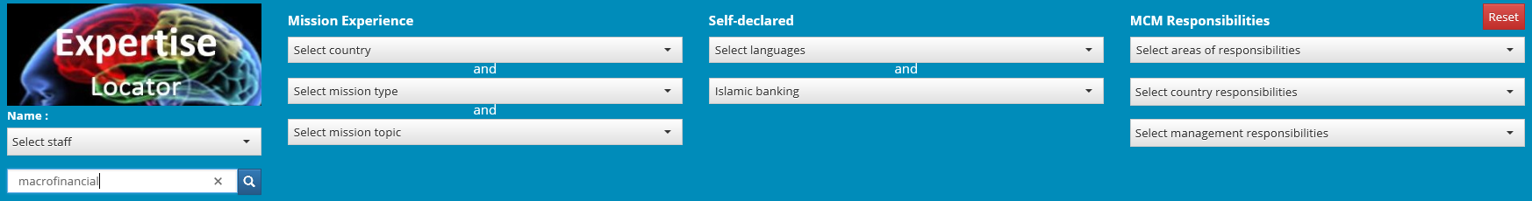
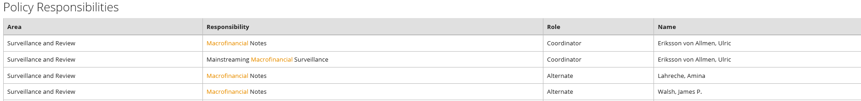
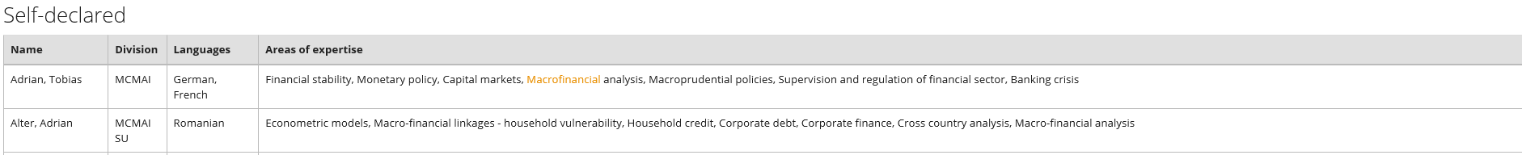
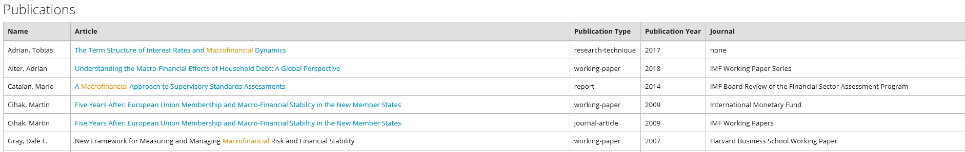

Slide 27
Sample Search Results 2:
Combine language skills with areas of expertise

Slide 28
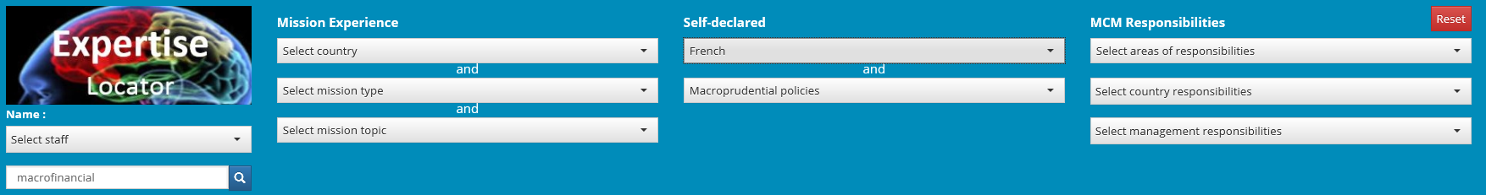
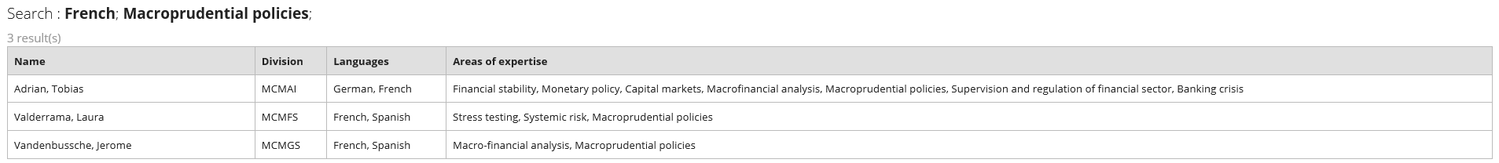

Slide 29
Sample Search Results 3:
Combine Country, Type of Mission and Mission Topic

Slide 30
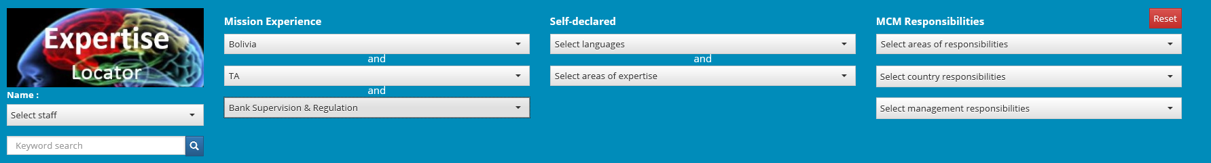
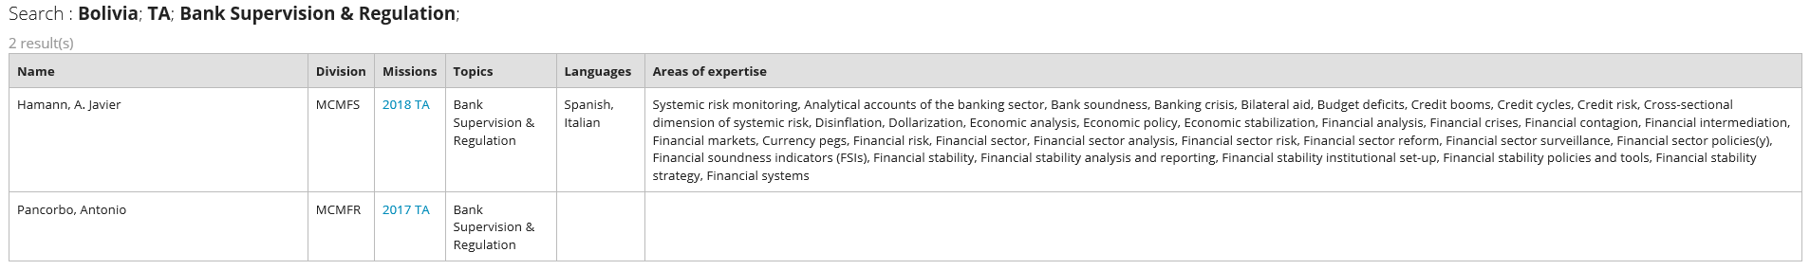

Slide 31
Sample Search Results 4:
MCM Policy Responsibilities by Area/Topic

Slide 32
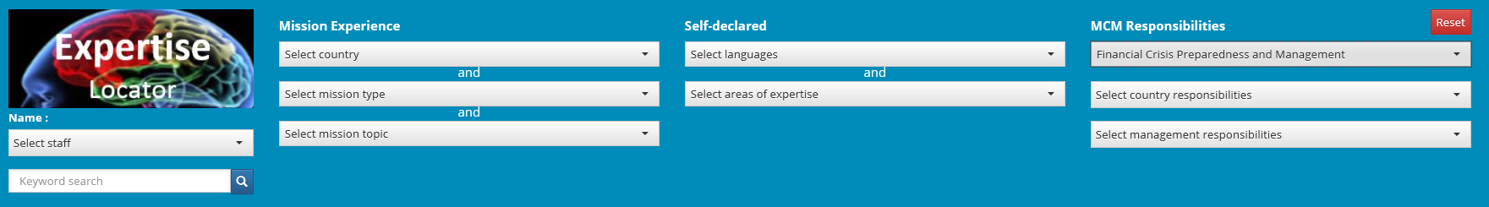
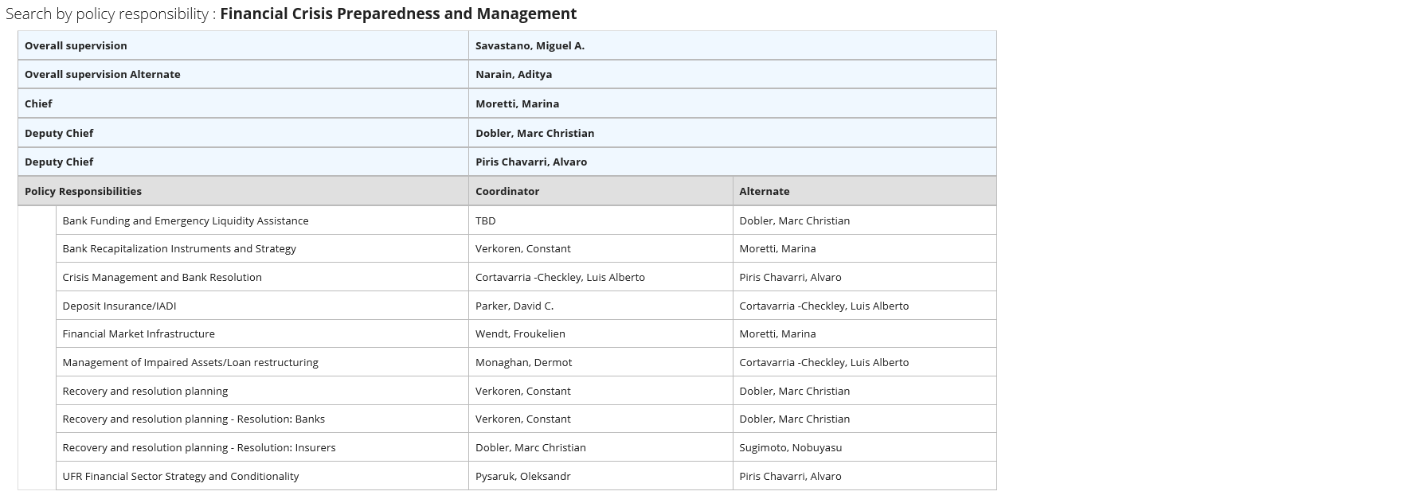

Slide 33
Sample Search Results 5:
MCM Country Responsibilities

Slide 34
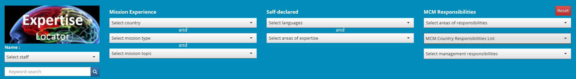
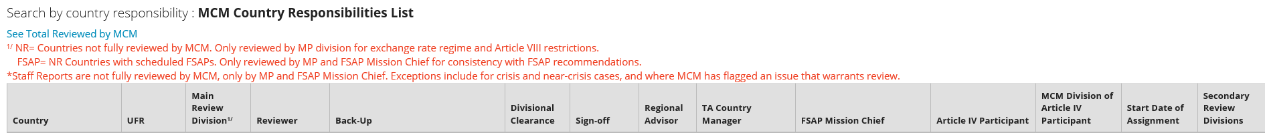
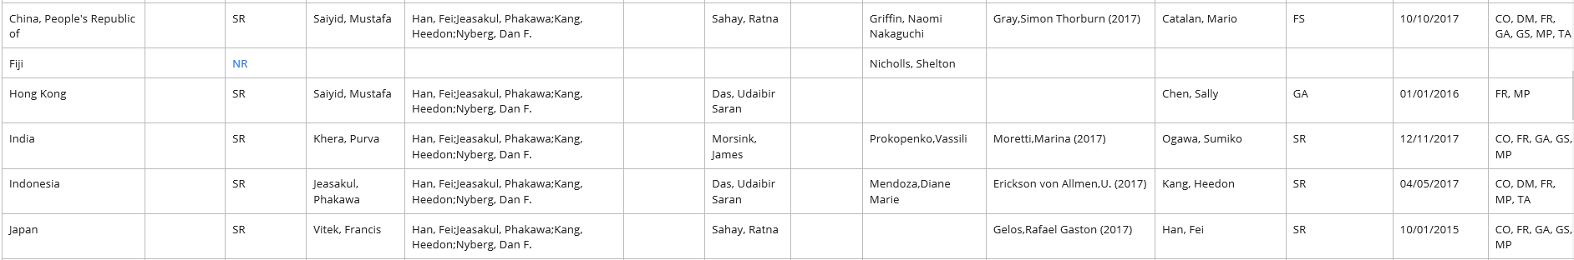

Slide 35
Sample Search Results 6:
MCM Regional Advisors or Art.IV Participants or B4-sign off

Slide 36
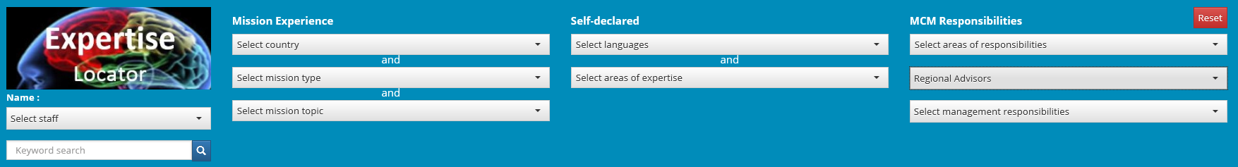
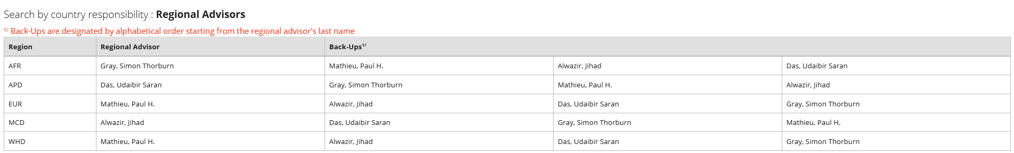
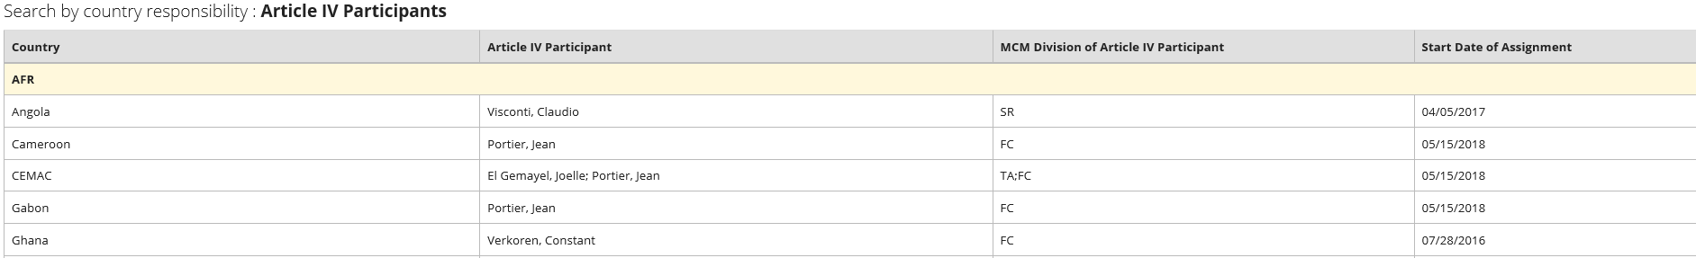
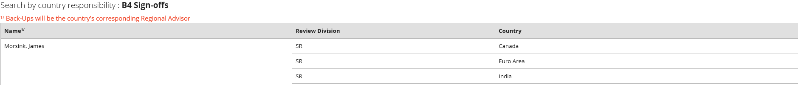

Slide 37
Sample Search Results 7:
MCM Management

Slide 38
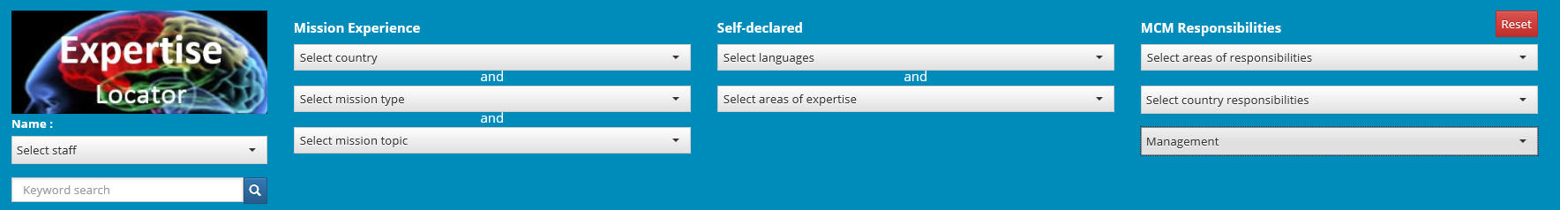
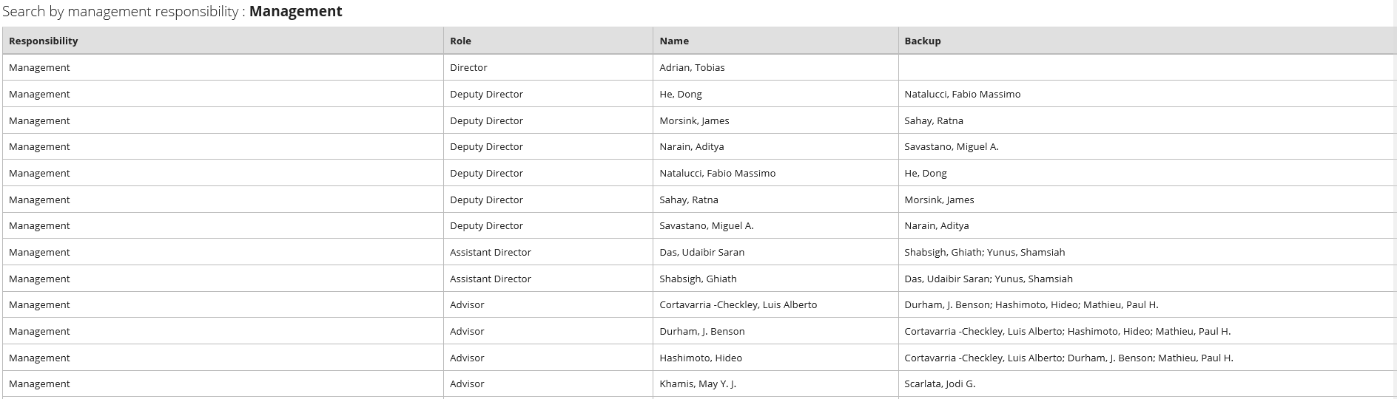
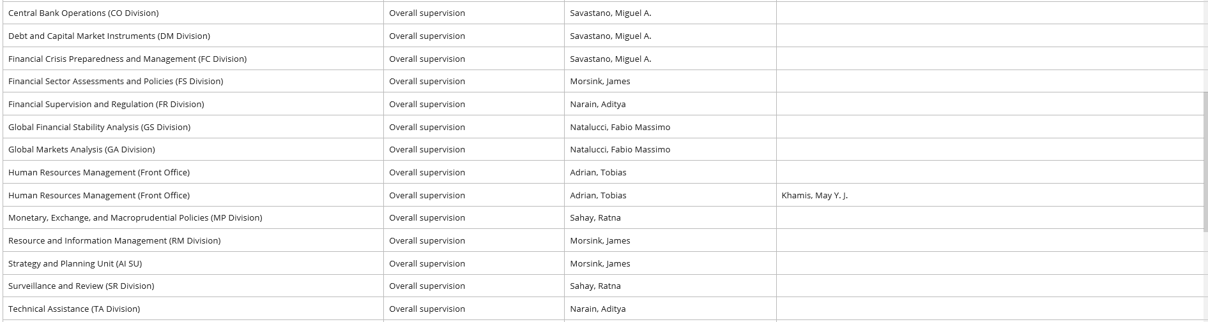
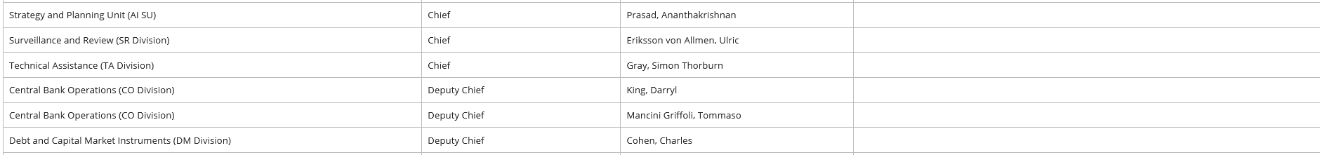

Slide 39
THANK YOU!
Questions…

