Slide 1


OAS KM GROUP
CEDOGR
Organizational Development
09/19/2019

Slide 2
Knowledge is the capacity for effective action
What is Knowledge?
Action
Knowledge
Experience
Decision Making
Learning Through Reflection

Slide 3
KM helps people share and put information & experiential knowledge into action in ways that improve organizational performance
What is Knowledge Management?
Knowledge is like paint. It does no good until it’s applied.
Action
Decision
Knowledge
Experience

Slide 4


What is KM?
"the management of knowledge"
Framework where expectations are set, actions are taken, and behaviors are put in place and sustained, to maximize the value of the know-how of the organization (Nick Milton)
Priority
Attention
It's how you manage, when you realize the importance of Knowledge. -Nick Milton

Slide 5
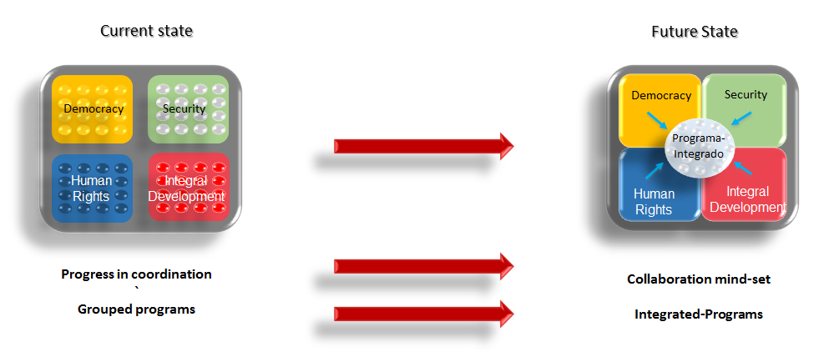
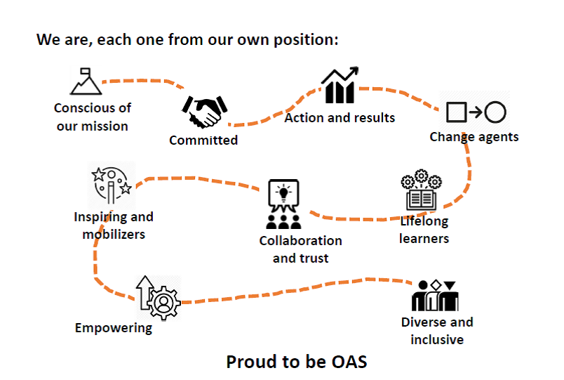
OAS’ Transformation & Culture change

Slide 6
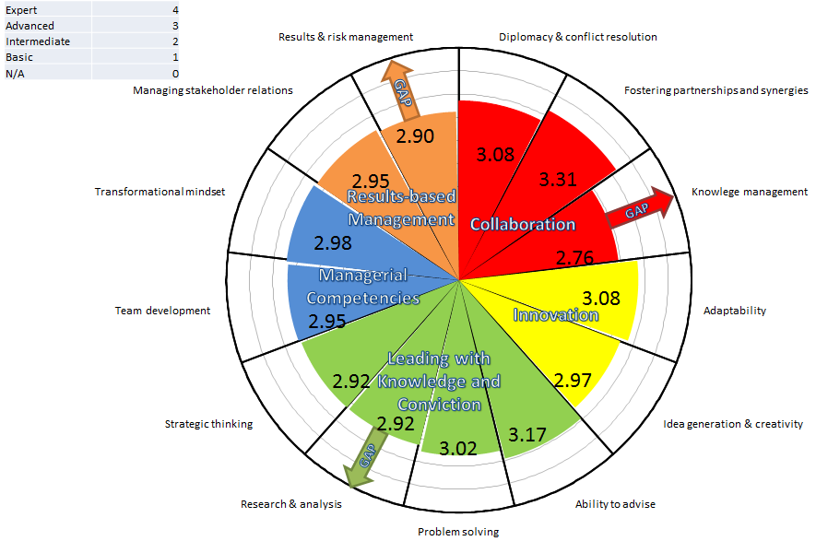
Competencies needed
Knowledge Management -one of the critical competencies for supporting collaboration, creation of new knowledge & innovation.

Slide 7
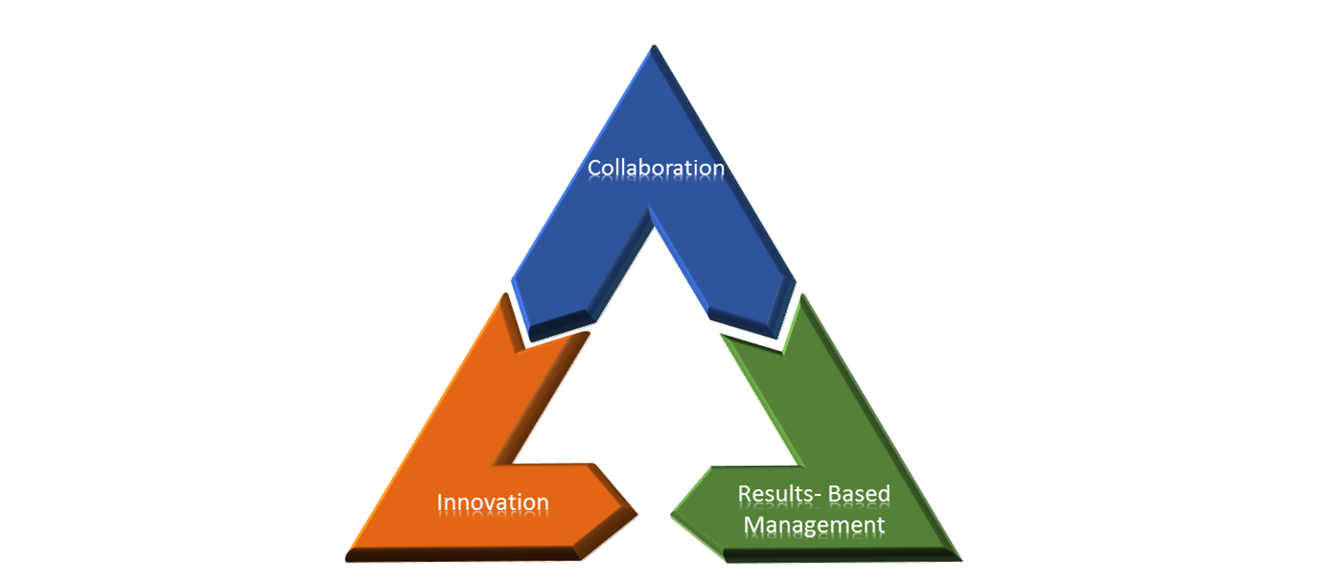
Knowledge sharing and knowledge management Empower our Personnel Create value for our Member States
Why do KM?

Slide 8




IT’S HOW WE WORK COLLABORATE, INNOVATE, DELIVER RESULTS
Embedding Knowledge Management
Access to critical knowledge
Collaboration & Coordination
Supporting better decision making
Capitalizing on our knowledge
Notes:
Providing access to critical knowledge to carryout work functions
Increasing collaboration and coordination
Supporting better decision making
Capitalizing on our accumulated knowledge to deliver stronger programs, projects and services

Slide 9






Some of the benefits of KM
Reducing time in the search for information,
and avoiding duplication of efforts
Avoid repeating mistakes
Enabling individual and organizational learning
Promoting greater collaboration and
integration of efforts to deliver results
Capturing & capitalizing on
institutional knowledge/ memory
Notes:
through a shared institutional spaces for sharing information and knowledge.

Slide 10
Resources:
Girard, John &Girard, JoAnn. Defining knowledge management: Toward an applied compendium. Online Journal of Applied Knowledge Management A Publication of the International Institute for Applied Knowledge Management Volume 3, Issue 1, 2015.
Filip, Barbara (2019) Presentation - KM 101 – in a rush. George Mason University. (Images adapted slides 2 & 3)
Jarche, Harold. PKM in action. Part 3. Posted 2019-08-14; filed under PKMastery https://jarche.com/2019/08/pkm-in-action-part-3/
Milton, Nick & Lambe, Patrick (2016), The Knowledge Manager’s Handbook: A step-by-step guide to embedding effective knowledge management in your organization.
Images Communities of Practice
https://www.nickmilton.com/2019/05/why-knowledge-management-is-not-oxymoron.html

Slide 11
Denise Goolsarran Strategic Counsel for Organizational Development and Management for Results Email: dgoolsarran@oas.org

