Slide 1



Blended Learning
Washington, DC
November 19, 2020

Slide 2

Agenda
Open Mic Virtual Icebreaker
Lesson for 5th: Don’t feed the phish
Team work
Sharing
Reflection about lesson
Tips
Closure
Questionnaire
Washington, DC
November 19, 2020

Slide 3

Open Mic Virtual Icebreaker (Courtesy of Selwyn)
Time: About 30 seconds
How-to:
Give everyone a heads up that they will have about a minute at the beginning of the meeting to take the virtual stage.
Ask them to find or write an icebreaker joke, read a poem, sing a song, play the mandolin, share an inspiring WhatsApp Message—anything they want!
Start your meeting with these glorious performances.
Allow ten seconds in between each for a rush of snaps and applause.

Slide 4

Don’t feed the phish
Washington, DC
November 19, 2020

Slide 5
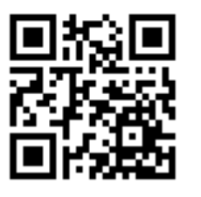
What did we learn?
By which activities?
With which materials?
How did we do it?
Can we deliver this class in blended learning mode?
http://gg.gg/n41f2

Slide 6

Tips for Blended Learning
Prioritize contents, based on international standards such as 21st Century Skills, ISTE, PISA.
Consider attention span:
Age X 2 = Amount of minutes students may pay attention to lecture or difficult explanations.
Age X 5 = Amount of minutes students may involved in some interesting and motivating activity.

Slide 7

Tips for Blended Learning
Online classes:
Elementary: 1 to 2 hours p/day plus self-study or tasks to do by themselves.
Middle school: 2 to 3 hours p/day plus self-study or tasks to do by themselves.
High school: 3 to 4 hours p/day plus self-study or tasks to do by themselves.
A course is classified as Hybrid if - 30-79% of the content is delivered online (The Sloan Consortium).

Slide 8
Tips for Blended Learning
Be sure students and/or parents know how to work with digital tools.
If kids are younger, a guide for the parents must be delivered.
Online classes may consider activities for wellbeing and socioemotional skills.
Participation from kids and collaborative activities must be included, as well as icebreakers and brain brakes (games).

Slide 9

Tips for Blended Learning
Project Based Learning (PBL):
  Present the whole project at once
  Divide the project into stages
  Summarize frequently, so students may be aware what they have done and what’s next.
    Allows for: Immediate feedback, more personalized pacing and become responsible for their own learning.

Slide 10
Tips for Blended Learning
Each session:
  Introduction
  Development
  Closure
  Evaluation
Connection “Dialogue”: within him/herself, with material (solving activities or graphic organizers), with peers, with community (interaction)

Slide 11
Asynchronous activities: first select learning goal, then what he/she has to do, careful planning, a guide for the student (if young, for the parents), estimate time, don´t ask for what cannot be evaluated.
Parents: training, coaching, follow-up

Slide 12

Metacognition is thinking about how you think and learn:
  Self-questioning
  Meditation -- mindfulness
  Identify strengths and weaknesses
  Graphic organizers
  Active reading strategies
  Planning ahead

Slide 13
5 Reasons why Blended Learning is Right for Special Education Students:
  Facilitates Small Group Instruction
  Provides Tailored Instruction (they work at their own pace)
  Engaging, ownership of their learning, motivation
  Creates a Culture of Differentiation
  Mastery-Based Learning
  Express their individuality in their work (no peer pressure)

Slide 14
“Large learning gains when traditional face-to-face guidance from the teacher, in conjunction with the benefits of virtual supplemental materials designed to reinforce instruction” (Bateman & Soifer, 2015).
“The blended classroom has demonstrated effectiveness in teaching core concepts and increasing the overall assessment of students with special needs and learning disabilities”-Journal of Education and Training Studies Vol.5, No 2; Feb 2017.

Slide 15
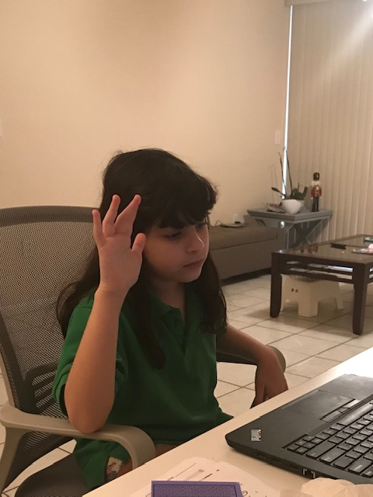
Remember who is the most important.

Slide 16

Closure
Draw and color the most important messages or lessons you are taking from the workshops.
  Uso a white sheet of paper and color with markers/color pencils.
  Share with all of us.

Slide 17

Sharing time

Slide 18
https://ciel.viu.ca/teaching-learning-pedagogy/designing-your-course/how-learning-works/ten-metacognitive-teaching-strategies
https://helpfulprofessor.com/metacognitive-strategies/
https://studylib.net/doc/5403405/blended-problem-based-learning---hci
Information on Special Education and Blended Learning:
https://specialeducareers.com/resources/blog/5-reasons-why-blended-learning-is-right-for-special-education-students#:~:text=Blended%20Learning%20focuses%20on%20mastery,environment%20due%20to%20this%20similarity.
https://www.researchgate.net/publication/312264267_The_Blended_Learning_Environment_A_Viable_Alternative_for_Special_Needs_Students
https://michiganvirtual.org/research/publications/supporting-students-with-disabilities-in-k-12-online-and-blended-learning/
https://www.kpu.ca/sites/default/files/Teaching%20and%20Learning/TD.5.2.6.Massoud_etal_Blended_Learning_to_Foster_Education.pdf
Resources:

Slide 19
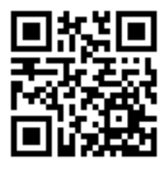
Please answer this questionnaire
http://gg.gg/n1s1t

Slide 20


