Slide 1
Knowledge Management at CIAT
Discussion with the OAS KM CoP sponsored by the Strategic Counsel for Organizational Development & Management for Results Organization of American States
Simone Staiger-Rivas
s.staiger@cgiar.org

Slide 2
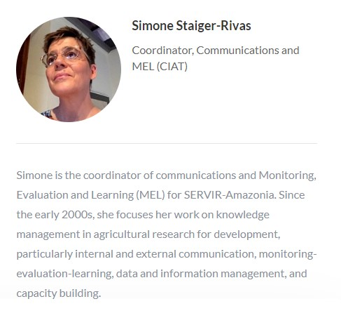

About Me
https://www.linkedin.com/in/simonestaiger/

Slide 3
“The quality of results produced by any system depends on the quality of awareness from which people in the system operate.” Otto Scharmer

Slide 4
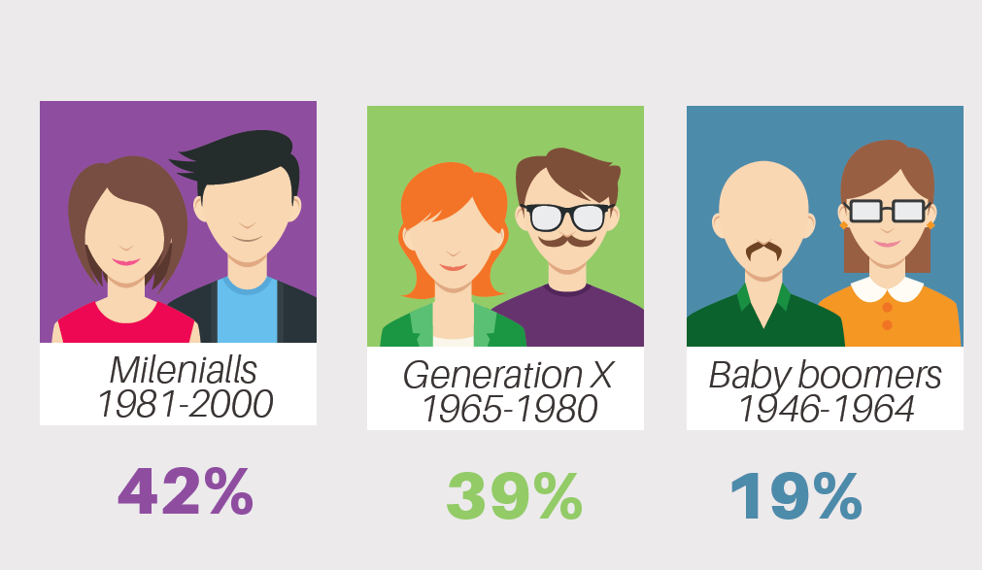


CIAT Culture
980 staff, 200 scientists
Diversity in nationalities (57 countries)
Generational shift 42% < 40 years
Less then 40% women, 24% in Research
Spanish and English
Scienstists under pressure to leverage funding
On a good day, at CIAT we see us as
Young
Dynamic
Pionneering new Research
Disruptive
Having a broad, unique research agenda
On a bad day, at CIAT we see us as
Working in silos
Resistant to change
Re-inveting the Wheel
With lack of leadershhip
Unable to unite admin and research

Slide 5
Changing emphasis
Knowledge Sharing 2005-2012
Social media
Online collaboration
Capacity Development 2013-2014
CapDev platforms
Knowledge Sharing in Research
2013-15
Data Management
2016-2017
Open access to data and information
Monitoring, Learning and Evaluation
2018- onwards
Facilitation
Theory of Change applied to projects
CapDev indicators
Research quality
Monitoring system at Program level
Knowledge Management components written into research projects (Climate change)
Connecting MEL, impact assessment and foresight
Theory of Change
Blogs a process documentation
Experience Capitalization
Global CGIAR MEL framework
Current KM capacity at CIAT
MEL team (2 full time and some part-time positions)
Data team: Around 15 (developers, statisticians…)

Slide 6
Changing priorities for Knowledge Management at CIAT
Monitoring, Evaluation and Learning
Monitoring at program level
Connection M&E, IA, Foresight, Learning
Data and information management
Open Access to data & information
Research quality
KM at project level
Theory of change at Project level
KM applied with Cliamte change projects / DAPA
KM& Capacity Development
CapDev Platforms
Use of Theory of Change
CapDev indicators
Knowledge Sharing @ CGIAR
Social media
Facilitation
Virtual Colaboration
ICT4D
Rural community telecenters
Rural Innovation Institute
2000
2010
2018

Slide 7
KM interventions along the impact pathway
Resources
Activities
Products
Results
Impact
Expected results
High quality research – Sphere of Control
Tools & methods are used –
Sphere of Influence
Changes in KAS enables at scale – Sphere of Concern
KM interventions
Planning the research
Sharing processes
Give access to data & info
Use of ICTs
Influence in policies
Co-create products
Engage in networks
External
Internal
Implementers
Partners
Users

Slide 8
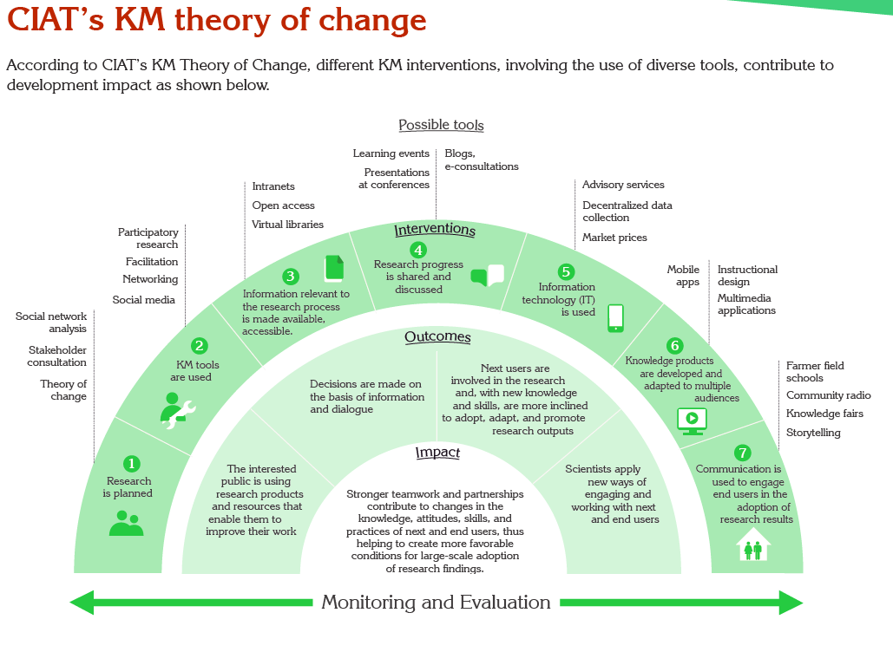

Slide 9
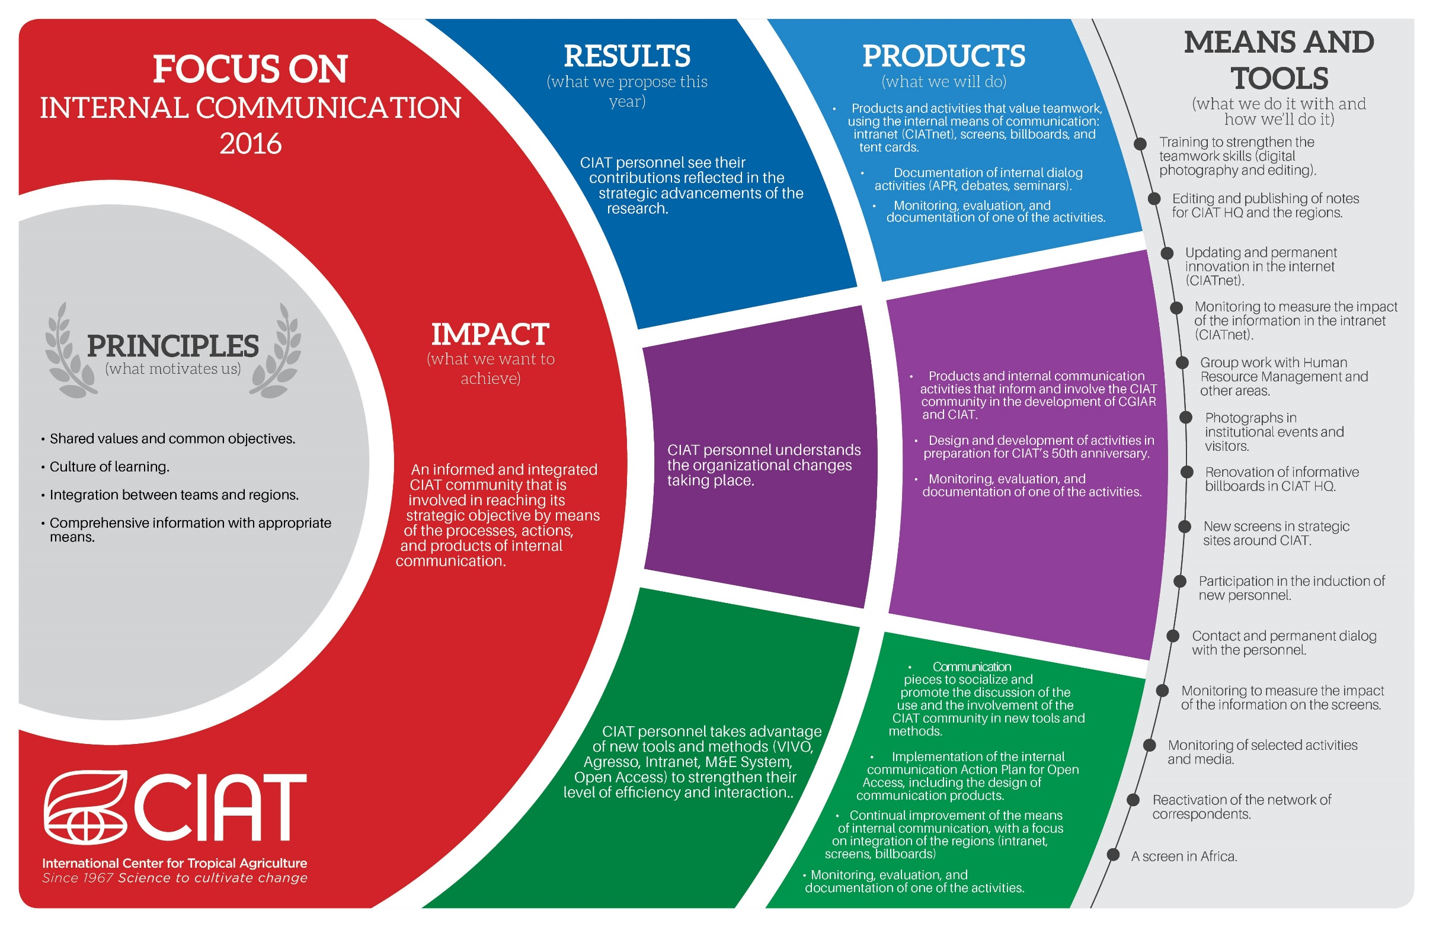
Annual Work Plans – Example 2016

Slide 10


Slide 11
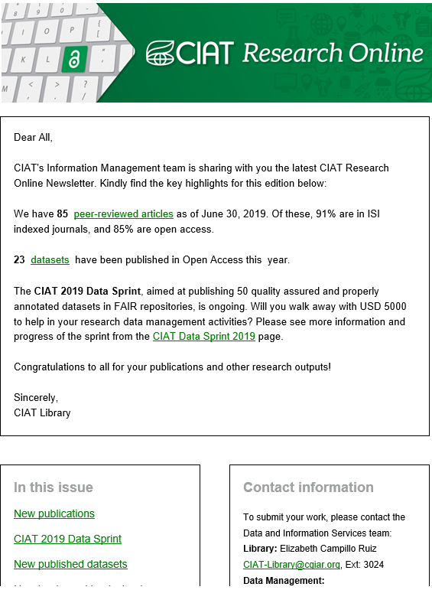

Slide 12
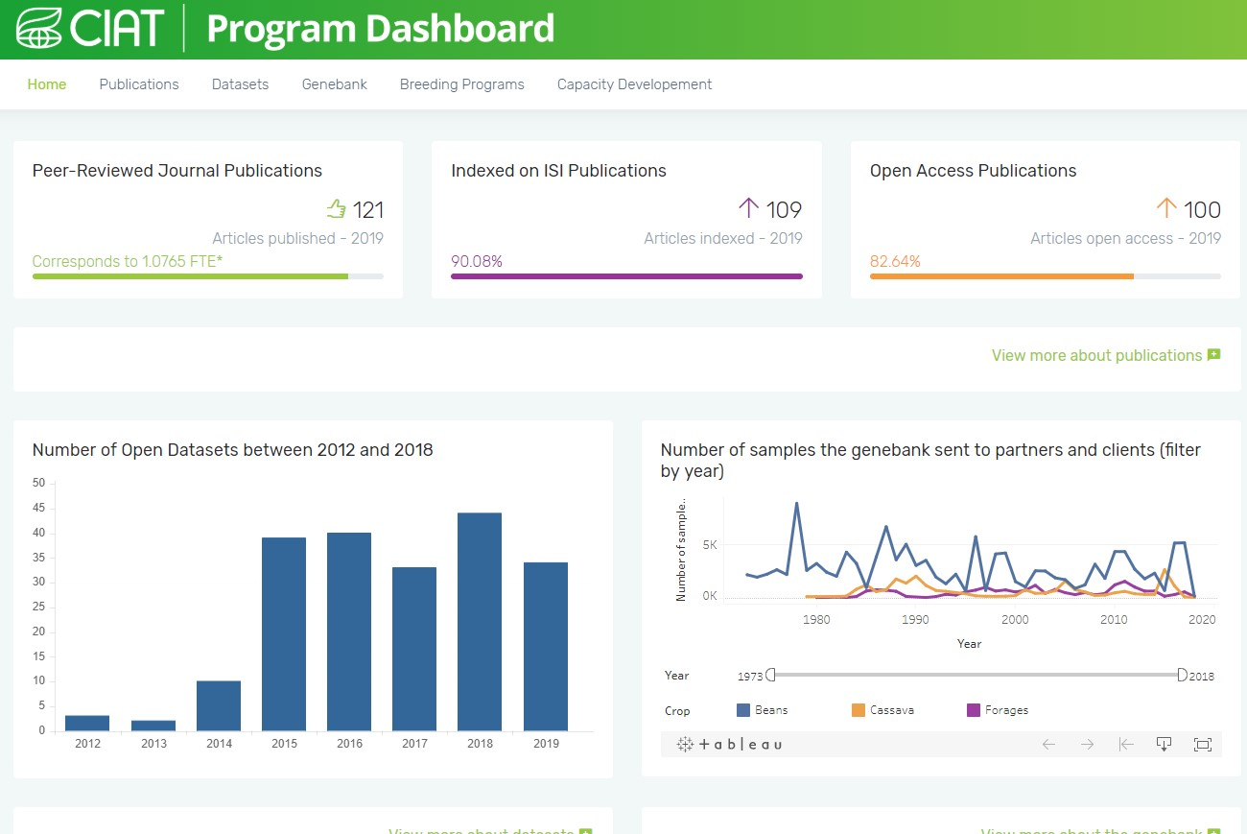

Slide 13
Key messages
KM can be almost anything. CIAT works on different KM aspects over time. Priorities were given by trends, CGIAR, and preferences / talents of staff. What is your priority?
Achievements: Better f2f and virtual interaction, use of ToC to lay basis of results-based management, increase in open access to data and information.
Failures: Focus on capacity development
Vision: From ToC, to MEL to a comprehensive results-based management ecosystem
KM at project level: Slowly getting into the project ecosystem with buy-in for KMers to participate in project proposals and planning phase

Slide 14


